Slide 1
Automatic Image Captioning
CP4

Slide 2
Introduction Team – Group 13
Hari Krishna Suguru
Keerthi Pakala
Manohar Rao Pagadala

Slide 3
Automatic Image Captioning
Objective: The objective of automatic image captioning is to generate properly formed English sentences to describe the content of an image automatically with help of CNN and LSTM
Dataset: Flickr8k_dataset , Flickr30k, cocodataset
Tools: Natural Language Toolkit, TensorFlow, Keras, pytorch , github

Slide 4
Covering Problem
With the rapid development of digitalization, there are a huge amount of images, accompanied with a lot of related texts . Automatic image captioning has recently attracted much research interest. The objective of automatic image captioning is to generate properly formed English sentences to describe the content of an image automatically, which is of great impact in various domains such as virtual assistants, image indexing, recommendation in editing applications, and the help of the disabled. Although it is an easy task for a human to describe an image, it becomes very difficult for a machine to perform such a task.
Image captioning does not only need to detect the objects contained in an image but also capture how these objects related to each other and their attributes as well as the activities involved in. Moreover, the semantic knowledge should be expressed in a natural language, which requires a language model to be developed based on the visual understanding With the rapid development of digitalization, there are a huge amount of images, accompanied with a lot of related texts . Automatic image captioning has recently attracted much research interest. The objective of automatic image captioning is to generate properly formed English sentences to describe the content of an image automatically, which is of great impact in various domains such as virtual assistants, image indexing, recommendation in editing applications, and the help of the disabled. Although it is an easy task for a human to describe an image, it becomes very difficult for a machine to perform such a task.
Image captioning does not only need to detect the objects contained in an image but also capture how these objects related to each other and their attributes as well as the activities involved in. Moreover, the semantic knowledge should be expressed in a natural language, which requires a language model to be developed based on the visual understanding

Slide 5
Literature Reviews
Automatic Image Captioning Based on ResNet50 and LSTM with Soft Attention Link
Automatic Image Captioning using Deep Learning (CNN and LSTM) in PyTorch Link
Deep Visual-Semantic Alignments for Generating Image Descriptions Link
Attention Is All You Need Link Link

Slide 6
Current State
Built 8K, 30K LSTM with Xception model
Flicker dataset
Built 8K, 30K CNN (EfficientNet) with Transformer model
Flicker dataset
RESNET150 model
Coco dataset
Comparing performance metrics between models
Evaluated caption prediction with BELU score
Deployed Model in Flask and Ngrok
Code is uploaded in Github

Slide 7
Methodologies
Xception model
CNN with LSTM
RESNET 150 and LSTM
Transformers
Evaluation of belu score

Slide 8
outcome
Dataset | Architecture/model | Epoch | Accuracy | Loss | Validation Accuracy | Validation Loss | Bleu score
8K | LSTM | 10 | 0.35 | 2.7868 | NA | NA | 1.288
30K | LSTM 30k | 10 | 0.29 | 3.9605 | NA | NA | 1.28
8K | CNN-Transformers | 12 | 0.50 | 11.21 | 0.4002 | 15.5382 | 8.17
30K | CNN-Transformers 30k | 9 | 0.50 | 11.07 | 0.40 | 15.44 | 8.188 | Model is saturated at 9 epoch and thereafter reducing validation accuracy @30 loss: 8.3651 - acc: 0.5938 - val_loss: 17.7453 - val_acc: 0.3784
30K | RESNET150 | 2 | NA | 1.9591 | NA | NA | 7.0931(Perplexity)

Slide 9
Challenges
For 30k training is taking long time and Google colab’s runtime is getting frequently disconnected.
Understanding Transformers little bit challenge.
There is no significant accuracy difference between from 8k and 32k

Slide 10
Applicable in Real world
Image search for commercial products
Quality inspection of product – identifying and labelling the problem.
Medical – detecting and summarizing the problem
Helpful for the disabled people

Slide 11

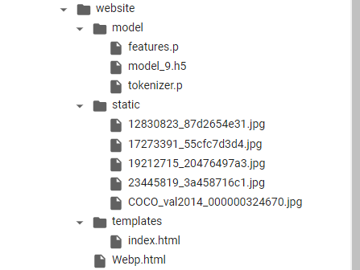
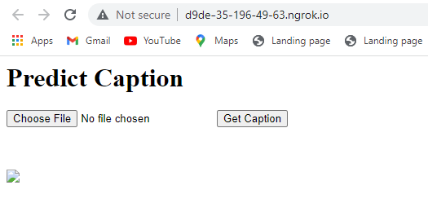
Model Deployment

Slide 12
Demo

Slide 13
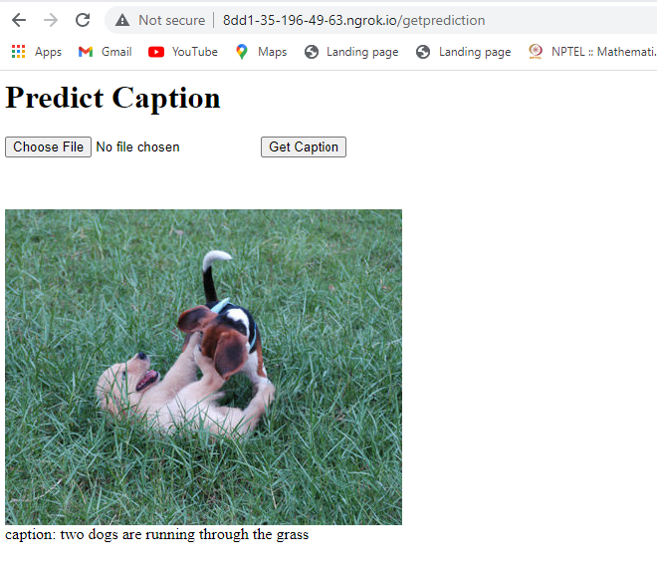
Demo 1

Slide 14
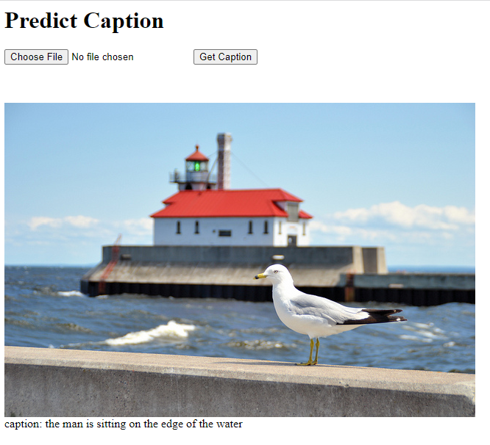
Demo 2 - Completely foreign Image

Slide 15
Thank you

Slide 16
CNN Transformer model
Image
CNN
ENCODER
DECODER
Output
Multi-Head Attention
Positional Encoding

Slide 17
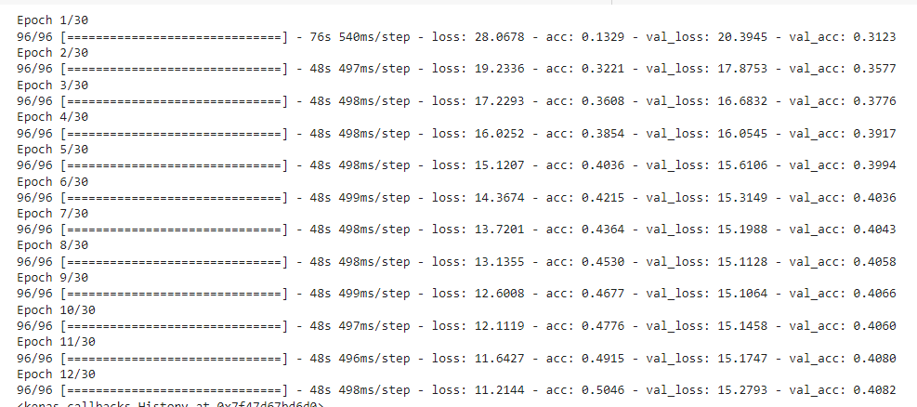
CNN Transformer Training

Slide 18
Dataset | Architecture/model | Epoch | Accuracy | Loss | Validation Accuracy | Validation Loss | Bleu score
8K | LSTM | 10 | 0.35 | 2.7868 | NA | NA | 1.288
30K | LSTM 30k | 10 | 0.29 | 3.9605 | NA | NA | 1.28
8K | CNN-Transformers | 12 | 0.50 | 11.21 | 0.4002 | 15.5382 | 8.17
30K | CNN-Transformers 30k | 9 | 0.50 | 11.07 | 0.40 | 15.44 | 8.188 | Model is saturated at 9 epoch and thereafter reducing validation accuracy @30 loss: 8.3651 - acc: 0.5938 - val_loss: 17.7453 - val_acc: 0.3784
30K | RESNET150 | 2 | NA | 1.9591 | NA | NA | 7.0931(Perplexity)

Slide 19
Model Deployment
Flask frame work for API
Ngrok – proxy for public access
Deployed saved mode in Flask

Slide 20
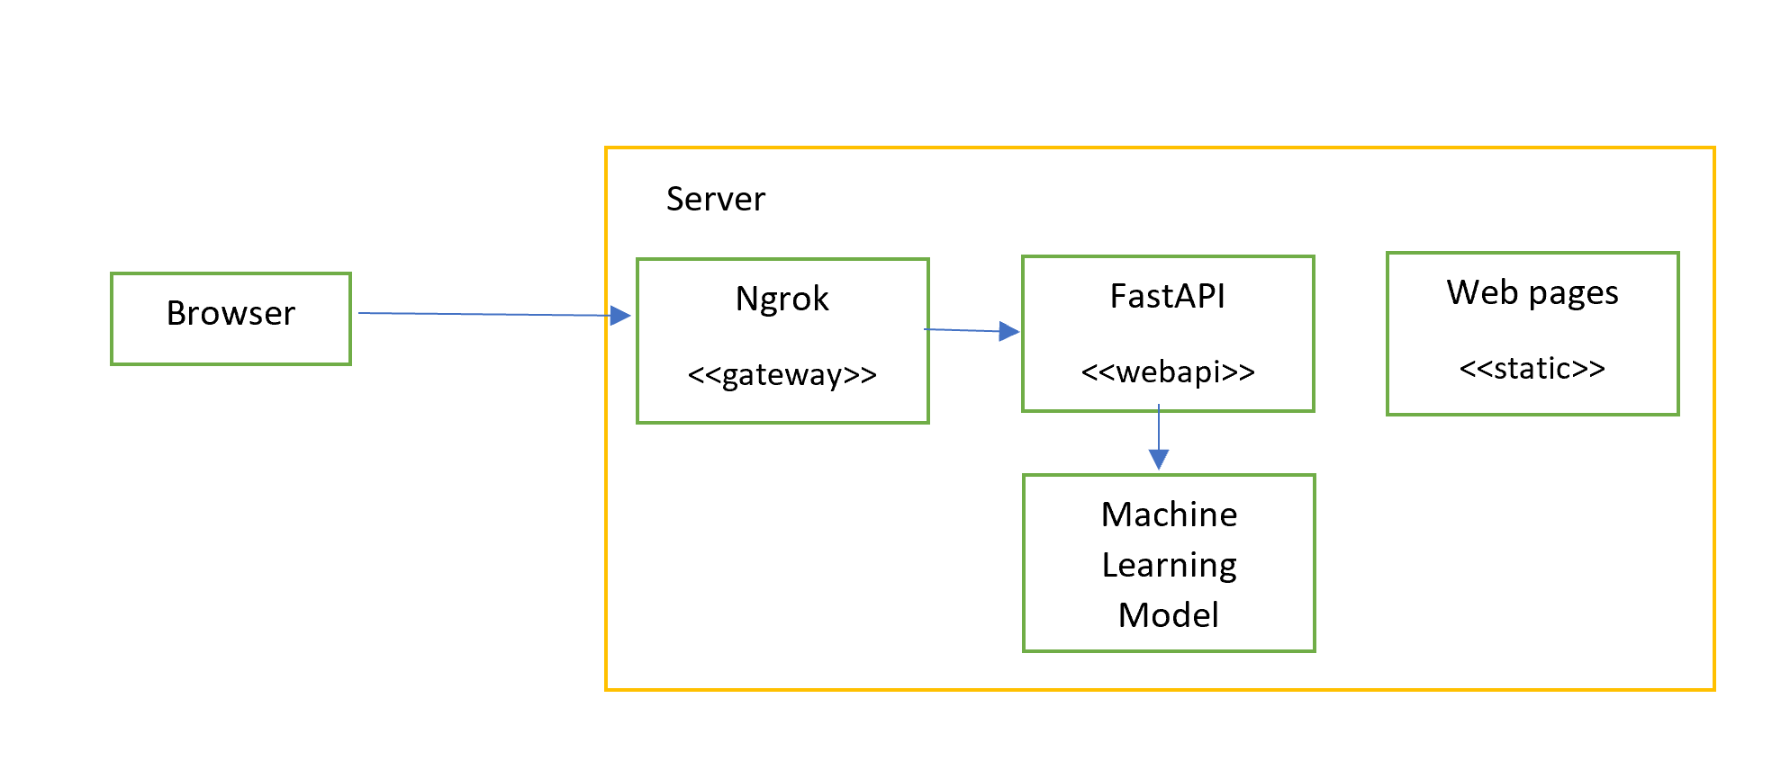
Model Deployment Architecture

Slide 21
Model Deployment - UI

Slide 22
Model Deployment UI

Slide 23
Completely foreign Image

Slide 24
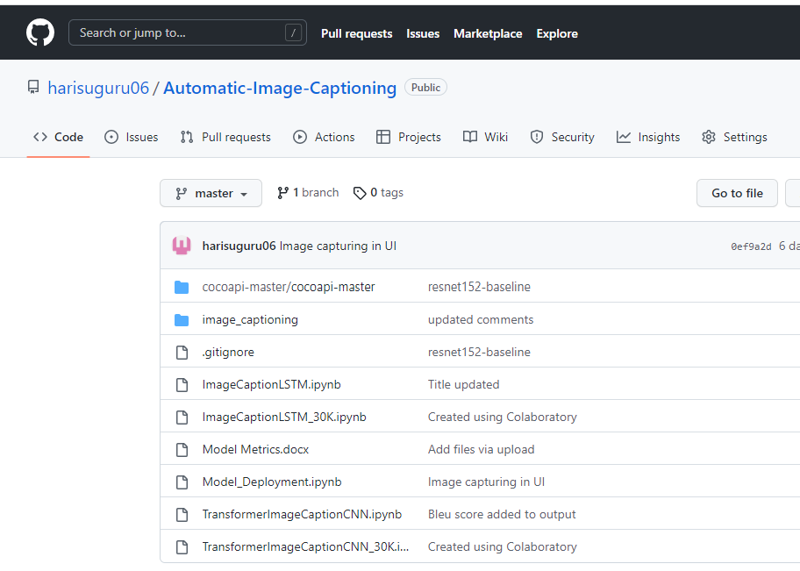
GIT

Slide 25
Next Tasks
Fine tune models to improve accuracy
Experiment with different learning rates
Testing model
References
https://keras.io/examples/vision/image_captioning/
https://flask.palletsprojects.com/en/2.2.x/
https://ngrok.com/

Slide 26
Stages In Machine Learning
Gathering Data
Downloading data https://cocodataset.org/#home
Train Images – 83K/13GB
Test Images – 41K/6GB
Preparing the Data
Transforming and resizing data
Choosing Model
RESNET-152 pretrained model
Common Object in Context (COCO) – Image recognition
Training
Training model with 5 epocs
Evaluation
Hyperparameter Turning
Prediction

Slide 27
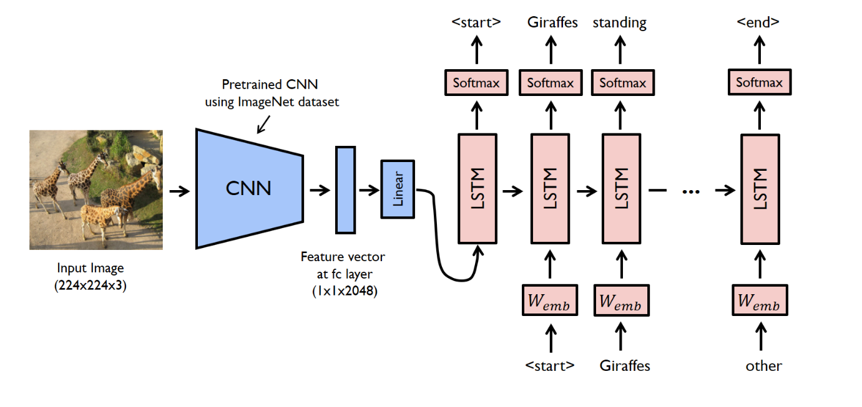
Architecture

Slide 28
Major Architecture components
COCO
--
Object Segmentation
Object Detection
nn.Module
EncoderCNN
--
Load Pretrained data
Remove Last Layer
Add FC layer
BatchNorm1d
DecoderCNN
--
nn.Embedding
nn.LSTM
nn.Linear
nn.LSTM
Vocabulary
--
Word2Index
Index2Word
Word Counter
Tokenize Sentences
Pickle
--
Serialize object
Deserialize object
Resnet152
--
Pretrained model

Slide 29
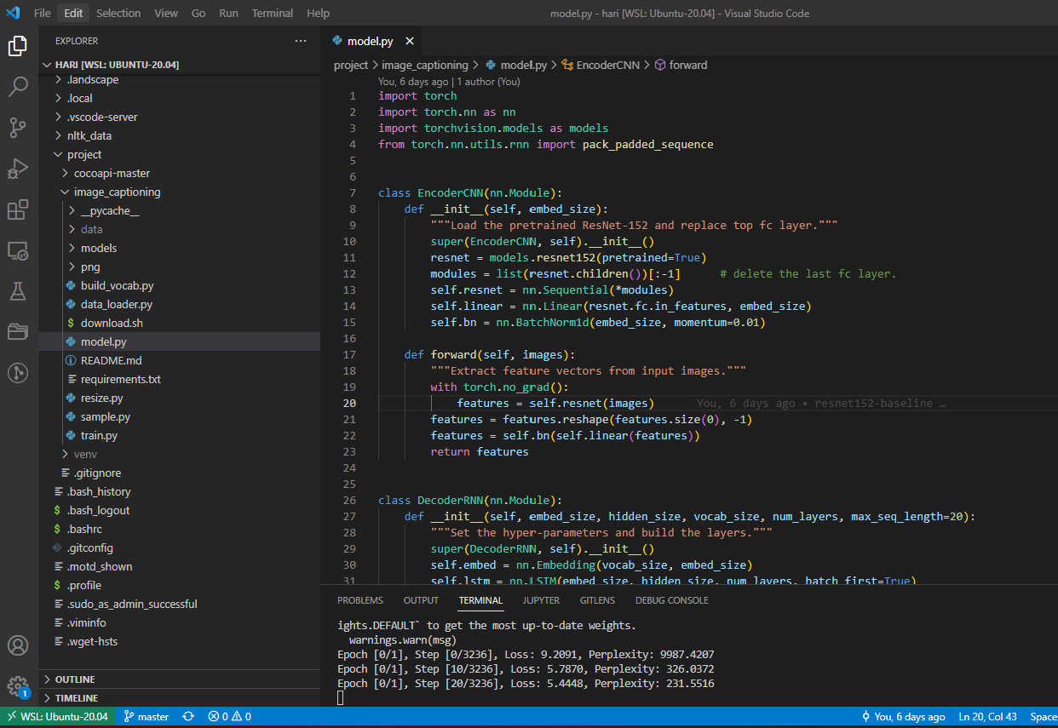
Building model in VSCode

Slide 30
Challenges
Existing sample has large data set i.e. 83K.
Training model with 5 epoc /128 batch size taking long time (days) in normal laptop
Some libraries are modified over a period of time, explored alternative to fix issues

